Slide 1
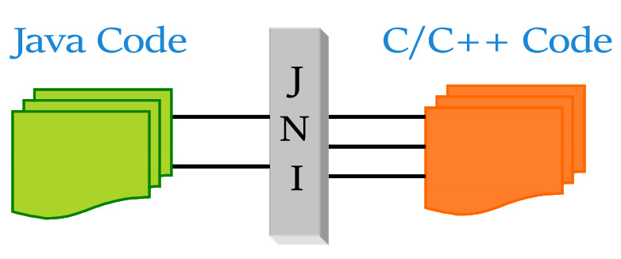
Training JNI Java Native Interface (Created by the.vu@lge.com)
Overview of Java
Introduce about JNI (Java Native Interface)
How to use JNI
JNI with Android
Questions and Answers
Ha Noi, 26 Nov 2019
Notes:
https://docs.oracle.com/javase/7/docs/technotes/guides/jni/spec/jniTOC.html

Slide 2

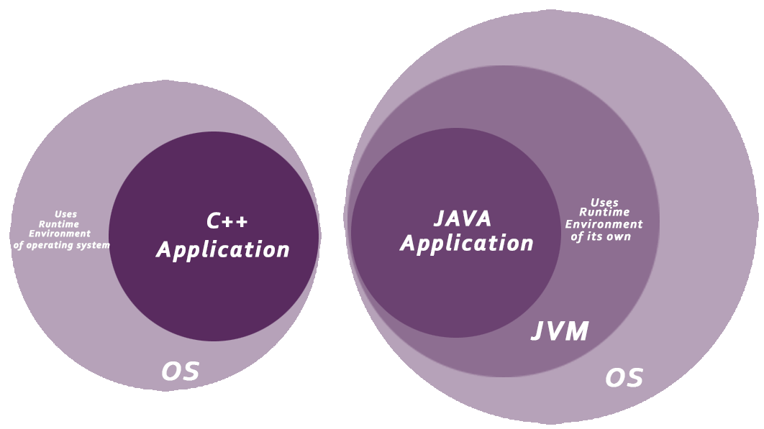
I. Overview of Java
Java is a programming language, first release is JDK 1.0 in in (January 23, 1996) and JDK 13.0.1 was already released as of 11/2019.
Java is a high level, robust, object-oriented and secure programming language.
Java was compiled to bytecode (instead of machine code
as other language as C++,C#,…) and JVM (Java Virtual Machine) will execute this bytecode on physical machine.
Sun Microsystems
(Oracle Corporation)
Notes:
https://www.javatpoint.com/java-tutorial
https://www.javatpoint.com/history-of-java

Slide 3
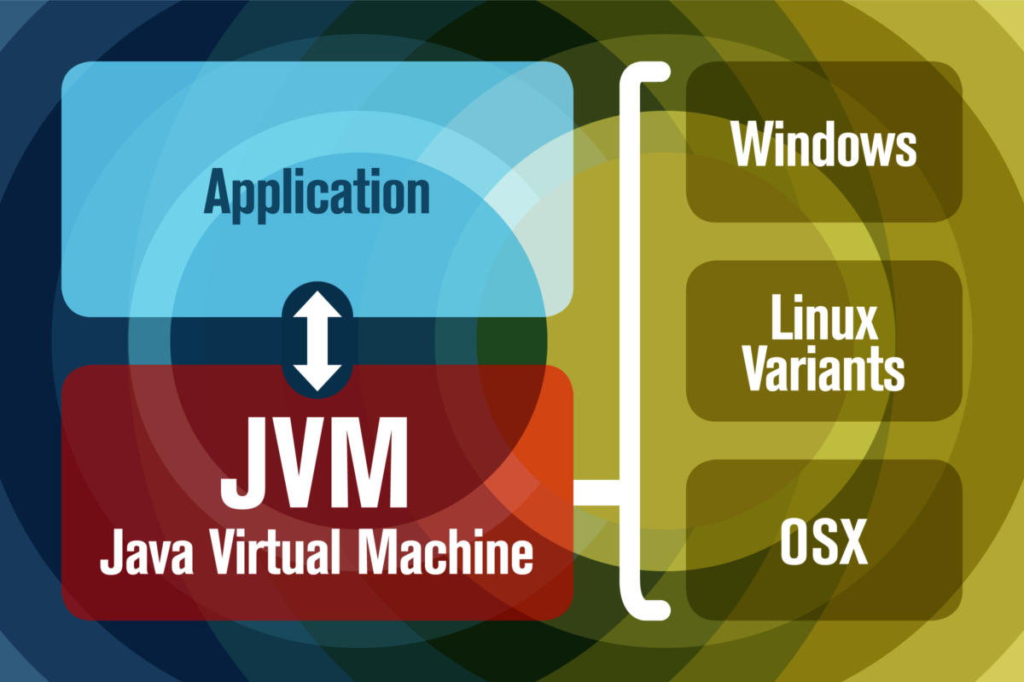
I. Overview of Java (JVM)
JVM has two primary functions:
Allow Java programs to run on any device or operating system (known as the "Write once, run anywhere" principle)
Manage and optimize program memory
Notes:
https://www.javaworld.com/article/3272244/what-is-the-jvm-introducing-the-java-virtual-machine.html

Slide 4
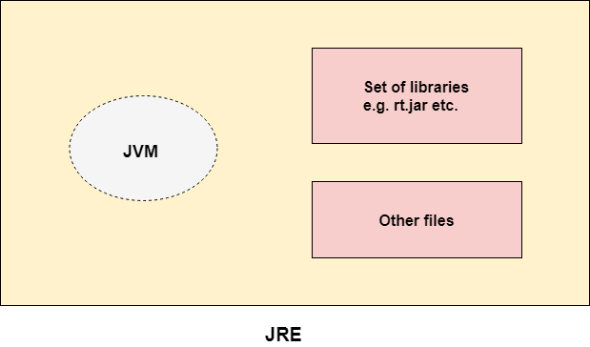
I. Overview of Java (JRE)
JRE is the implementation of JVM
JRE contains a set of libraries + other files that JVM uses at runtime.
(Java Runtime Environment)
Link: https://www.oracle.com/technetwork/java/javase/downloads/jre8-downloads-2133155.html
https://www.oracle.com/technetwork/java/javase/downloads/jdk8-downloads-2133151.html
(Notice: From Java SE 9 (9/2017), JRE was included in JDK)
Notes:
https://www.javatpoint.com/difference-between-jdk-jre-and-jvm

Slide 5
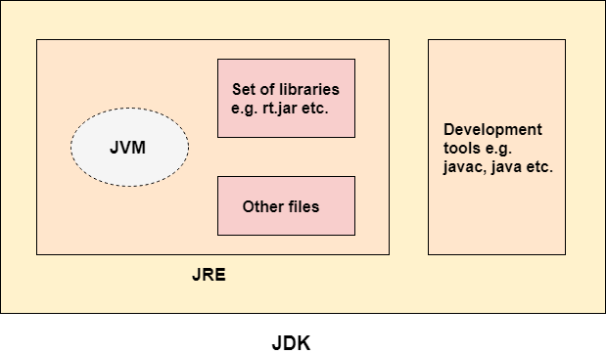
I. Overview of Java (JDK)
JDK is a software development environment which is used to develop Java applications and applets. It physically exists.
It contains JRE + development tools.
(Java Development Kit)
Link: https://www.oracle.com/technetwork/java/javase/downloads/jdk13-downloads-5672538.html
Notes:
https://www.javatpoint.com/difference-between-jdk-jre-and-jvm

Slide 6
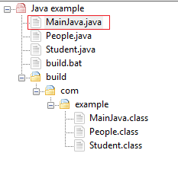
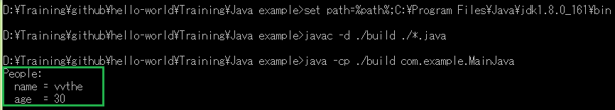
I. Overview of Java (Compile and Execute)
1. Set JDK path
set path=%path%;C:\Program Files\Java\jdk1.8.0_161\bin
2. To compile:
javac -d ./build ./*.java
3. To execute:
java -cp ./build com.example.MainJava
Notes:
https://www.codejava.net/java-core/tools/using-javac-command

Slide 7
II. Introduce about JNI (Java Native Interface)
The JNI is a native programming interface. It allows Java code that runs inside a Java Virtual Machine (VM) to interoperate with applications and libraries written in other programming languages, such as C, C++, and assembly.
Why and When ?
To access facilities of the operating system not provided via the standard Java libraries.
You have some library or code already written in C/C++ that you want to interface with without porting it to Java.
In a few rare cases where there is a proven performance benefit (e.g. because you know your particular C compiler can optimise some particular code better than the JVM's JIT compiler).
Notes:
https://www3.ntu.edu.sg/home/ehchua/programming/java/JavaNativeInterface.html

Slide 8
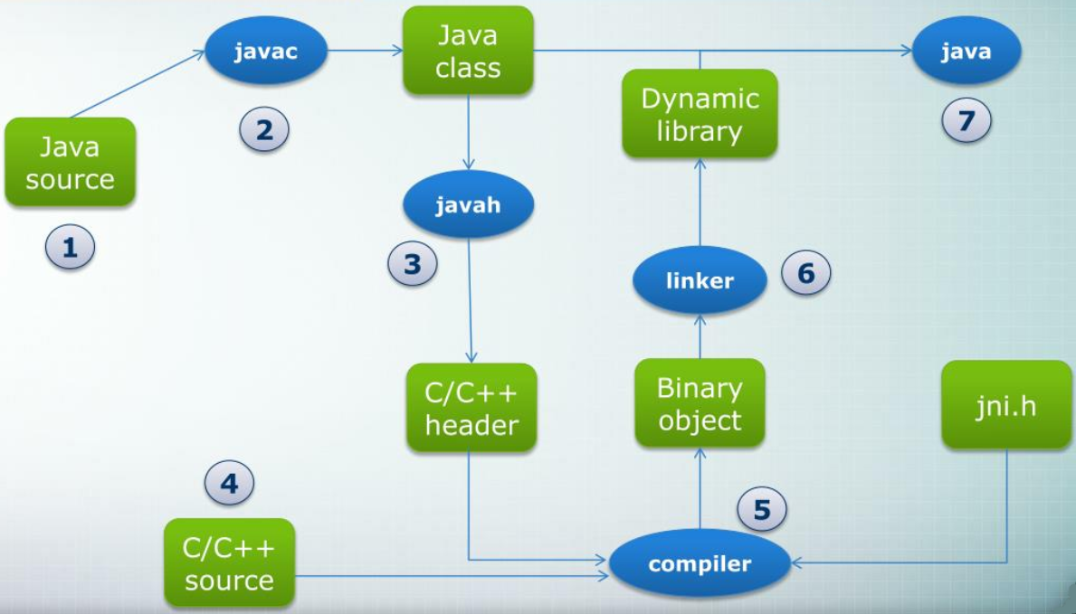
II. Introduce about JNI (compile and execute)
.class
.so
.java
.h
.o
.cpp
Notes:
https://www3.ntu.edu.sg/home/ehchua/programming/java/JavaNativeInterface.html

Slide 9
II. Introduce about JNI (simple example)
// Save as "HelloJNI.java"
public class HelloJNI {
static {//load .so,.dll
System.loadLibrary(“program");
}
private native void sayHello();
public static void main(String[] args) {
new HelloJNI().sayHello();
}
}
// Save as “Program.cpp"
#include <jni.h> // JNI header provided by JDK
#include <iostream> // C++ standard IO header
#include "HelloJNI.h" // Generated
using namespace std;
// Implementation of the native method sayHello()
JNIEXPORT void JNICALL Java_HelloJNI_sayHello
(JNIEnv *env, jobject thisObj) {
cout << "Hello World from C++!" << endl;
return;
}
//complie to HelloJNI.class
> javac HelloJNI.java
//generate HelloJNI.h
> javah HelloJNI
//compile Program.cpp to program.so
g++ -fPIC -I"$JAVA_HOME/include" -I"$JAVA_HOME/include/linux" -shared -o libprogram.so Program.cpp
//execute:
> java -Djava.library.path=. HelloJNI
Notes:
https://www3.ntu.edu.sg/home/ehchua/programming/java/JavaNativeInterface.html#zz-2.2

Slide 10
III. How to use JNI
1. Passing Arguments and Result between Java & Native Programs
2. Accessing Object's Variables and Calling Back Methods
3. Creating Objects and Object Arrays
4. Local and Global References
5. JNI Common Errors
6. Debugging JNI ProgramsPassing Arguments and Result between Java & Native Programs
Notes:
https://www3.ntu.edu.sg/home/ehchua/programming/java/JavaNativeInterface.html#zz-4.

Slide 11
III. How to use JNI
1. Passing Arguments and Result between Java & Native Programs
1.1.1 Passing Primitives (table mapping)
Java primitive | C/C++ (jni.h, jni_md.h) | C/C++ primitive | bytes
boolean | jboolean | unsigned char | 1
byte | jbyte | signed char | 1
char | jchar | unsigned short | 2
short | jshort | short | 2
int | Jint, jsize | long | 4
long | jlong | __int64 | 8
float | jfloat | float | 4
double | jdouble | double | 8
Notes:
https://www3.ntu.edu.sg/home/ehchua/programming/java/JavaNativeInterface.html#zz-4.

Slide 12
III. How to use JNI
1. Passing Arguments and Result between Java & Native Programs
1.1.2 Passing Primitives
//In HelloJNI.java
private native double testJNIPrimitive(boolean a, byte b, char c, short d, int e,long f, float g,double h);
//In Program.cpp
JNIEXPORT jdouble JNICALL Java_HelloJNI_testJNIPrimitive
(JNIEnv * env, jobject thisObj, jboolean a, jbyte b, jchar c, jshort d, jint e, jlong f, jfloat g, jdouble h){
printf("C++:\n");
printf("%d %d %c %d %d %lld %f %f\n",a,b,c,d,e,f,g,h);
jdouble ret = b + c + d + e + f + g + h;
return ret;
}
Notes:
https://www3.ntu.edu.sg/home/ehchua/programming/java/JavaNativeInterface.html#zz-4.

Slide 13
III. How to use JNI
1. Passing Arguments and Result between Java & Native Programs
1.2.1 Passing Array of Primitives (table mapping)
Java array of primitive | C/C++ (jni.h, jni_md.h) | C/C++ primitive
boolean[] | jbooleanArray | Pointer
byte[] | jbyteArray | pointer
char[] | jcharArray | pointer
short[] | jshortArray | pointer
int[] | jintArray | pointer
long[] | jlongArray | pointer
float[] | jfloatArray | pointer
double[] | jdoubleArray | pointer
Notes:
https://www3.ntu.edu.sg/home/ehchua/programming/java/JavaNativeInterface.html#zz-4.

Slide 14
III. How to use JNI
1. Passing Arguments and Result between Java & Native Programs
1.2.2 Passing Array of Primitives
//In Program.cpp
JNIEXPORT jdoubleArray JNICALL Java_HelloJNI_testJNIArrayPrimitive
(JNIEnv *env, jobject thisObj, jintArray inJNIArray) {
// Step 1: Convert the incoming JNI jintarray to C's jint[]
jint *inCArray = env->GetIntArrayElements(inJNIArray, NULL);
if (NULL == inCArray) return NULL;
jsize length = env->GetArrayLength(inJNIArray);
// Step 2: Perform its intended operations
jint sum = 0; int i;
for (i = 0; i < length; i++) { sum += inCArray[i]; }
jdouble average = (jdouble)sum / length;
// release resources
env->ReleaseIntArrayElements(inJNIArray,inCArray,0);
jdouble outCArray[] = {sum, average};
//Step 3: Convert the C's Native jdouble[] to JNI jdoublearray, and return
jdoubleArray outJNIArray = env->NewDoubleArray(2); // allocate
if (NULL == outJNIArray) return NULL;
env->SetDoubleArrayRegion(outJNIArray,0,2,outCArray); // copy
return outJNIArray;
}
//In HelloJNI.java
private native double[] testJNIArrayPrimitive(int[] numbers);
Notes:
https://www3.ntu.edu.sg/home/ehchua/programming/java/JavaNativeInterface.html#zz-4.

Slide 15
III. How to use JNI
1. Passing Arguments and Result between Java & Native Programs
1.3 Passing Strings
//In Program.cpp
JNIEXPORT jstring JNICALL Java_HelloJNI_testJNIString
(JNIEnv *env, jobject thisObj, jstring inJNIStr) {
// Step 1: Convert the JNI String (jstring) into C-String (char*)
const char *inCStr = env->GetStringUTFChars(inJNIStr, NULL);
if (NULL == inCStr) return NULL;
// Step 2: Perform its intended operations
printf("In C, the received string is: %s\n", inCStr);
env->ReleaseStringUTFChars(inJNIStr, inCStr); // release resources
// Prompt user for a C-string
char outCStr[128];
printf("Enter a String: ");
scanf("%s", outCStr); // not more than 127 characters
// Step 3: Convert the C-string (char*) into JNI String (jstring) and return
return env->NewStringUTF(outCStr);
}
//In HelloJNI.java
private native String testJNIString(String msg);
Notes:
https://www3.ntu.edu.sg/home/ehchua/programming/java/JavaNativeInterface.html#zz-4.

Slide 16
III. How to use JNI
2. Accessing Object's Variables and Calling Back Methods
2.1.1 Accessing Object's Variables (primitive variable)
//In Program.cpp
JNIEXPORT void JNICALL Java_HelloJNI_testModifyInstanceVariable
(JNIEnv * env, jobject thisObj) {
// Get a reference to this object's class
jclass thisClass = env->GetObjectClass(thisObj);
// int
// Get the Field ID of the instance variables "number"
jfieldID fidNumber = env->GetFieldID(thisClass, "number", "I” );
if (NULL == fidNumber) return;
// Get the int given the Field ID
jint number = env->GetIntField(thisObj, fidNumber);
printf("In C, the int is %d\n", number);
// Change the variable
number = 99;
env->SetIntField(thisObj, fidNumber, number);
}
//In HelloJNI.java
private int number = 88;
private String message = "Hello from Java";
private native void testModifyInstanceVariable();
GetFieldID
Get<type>Field
Set<type>Field
field descriptor
Name of variable
Notes:
https://www3.ntu.edu.sg/home/ehchua/programming/java/JavaNativeInterface.html#zz-4.

Slide 17
III. How to use JNI
2. Accessing Object's Variables and Calling Back Methods
2.1.2 Accessing Object's Variables (object variable)
//In Program.cpp
JNIEXPORT void JNICALL Java_HelloJNI_testModifyInstanceVariable
(JNIEnv * env, jobject thisObj) {
jclass thisClass = env->GetObjectClass(thisObj);
// Get the Field ID of the instance variables "message"
jfieldID fidMessage = env->GetFieldID(thisClass, "message", "Ljava/lang/String;");
if (NULL == fidMessage) return;
// String
// Get the object given the Field ID
jstring message = (jstring)env->GetObjectField(thisObj, fidMessage);
// Create a C-string with the JNI String
const char *cStr = env->GetStringUTFChars(message, NULL);
if (NULL == cStr) return;
printf("In C, the string is %s\n", cStr);
env->ReleaseStringUTFChars(message, cStr);
// Create a new C-string and assign to the JNI string
message = env->NewStringUTF("Hello from C");
if (NULL == message) return;
// modify the instance variables
env->SetObjectField(thisObj, fidMessage, message);
}
//In HelloJNI.java
private int number = 88;
private String message = "Hello from Java";
private native void testModifyInstanceVariable();
field descriptor
GetFieldID
GetObjectField
SetObjectField
Name of variable
Notes:
https://www3.ntu.edu.sg/home/ehchua/programming/java/JavaNativeInterface.html#zz-4.

Slide 18
III. How to use JNI
2. Accessing Object's Variables and Calling Back Methods
2.1.3 Accessing Object's Variables (Field descriptor table)
Java Type | C++ Field descriptor | C++ Get Method | C++ Set Method
Boolean/boolean[] | "Z“ / “[Z“ | GetBooleanField | SetBooleanField
Byte/byte[] | "B“ / “[B" | GetByteField | SetByteField
Char/char[] | "C“ / “[C“ | GetCharField | SetCharField
Short/short[] | "S“ / “[S" | GetShortField | SetShortField
int/int[] | "I“ / “[I" | GetIntField | SetIntField
long/long[] | "J" / “[J" | GetLongField | SetLongField
floa/float[] | "F“ / “[F" | GetFloatField | SetFloatField
Double/double[] | "D“ / “[D" | GetDoubleField | SetDoubleField
A Java class (object) | L<fully-qualified-name> | GetObjectField | SetObjectField
Notes:
https://www3.ntu.edu.sg/home/ehchua/programming/java/JavaNativeInterface.html#zz-4.
Descriptor for a Java classs:
HelloJNI class -> “LHelloJNI”
If declare “class DATA” nested in HelloJNI classs
Data class -> “LHelloJNI$Data”

Slide 19
III. How to use JNI
2. Accessing Object's Variables and Calling Back Methods
2.1.4 Accessing Class' Static Variables
//In Program.cpp
JNIEXPORT void JNICALL Java_HelloJNI_testModifyInstanceVariable
(JNIEnv * env, jobject thisObj) {
// Get a reference to this object's class
jclass cls = env->GetObjectClass(thisObj);
// Read the int static variable and modify its value
jfieldID fidS_Number = env->GetStaticFieldID(cls, "s_number", "D");
if (NULL == fidS_Number) return;
jdouble s_number = env->GetStaticDoubleField(cls, fidS_Number);
printf("In C, the double is %f\n", s_number);
s_number = 77.88;
env->SetStaticDoubleField(cls, fidS_Number, s_number);
}
//In HelloJNI.java
private static double s_number = 55.66;
Name of variable
field descriptor
GetStaticFieldID
GetStatic<type>Field
SetStatic<type>Field
Notes:
https://www3.ntu.edu.sg/home/ehchua/programming/java/JavaNativeInterface.html#zz-4.

Slide 20
III. How to use JNI
2. Accessing Object's Variables and Calling Back Methods
2.2.1 Callback Instance Methods
//In Program.cpp
JNIEXPORT void JNICALL Java_HelloJNI_testCallbackMethod
(JNIEnv * env, jobject thisObj) {
//Get a class reference for this object
jclass thisClass = env->GetObjectClass( thisObj);
//call method of Java class
jmethodID midCallBackAverage = env->GetMethodID( thisClass,
"callbackAverage", "(II)D");
if (NULL == midCallBackAverage) return;
jdouble average = env->CallDoubleMethod( thisObj, midCallBackAverage, 2, 3);
printf("In C, the average is %f\n", average);
}
//In HelloJNI.java
private double callbackAverage(int n1, int n2){
return ((double)n1 + n2) / 2.0;
}
private native void testCallbackMethod();
Name of Java Method
method descriptor
GetMethodID
CallDoubleMethod
Notes:
https://www3.ntu.edu.sg/home/ehchua/programming/java/JavaNativeInterface.html#zz-5.3

Slide 21
III. How to use JNI
2. Accessing Object's Variables and Calling Back Methods
2.2.2 Callback Static Methods
//In Program.cpp
JNIEXPORT void JNICALL Java_HelloJNI_ testCallbackMethod
(JNIEnv * env, jobject thisObj) {
//Get a class reference for this object
jclass thisClass = env->GetObjectClass( thisObj);
//Get method ID
jmethodID midCallBackStatic = env->GetStaticMethodID( thisClass,
"callbackStatic", "()Ljava/lang/String;");
if (NULL == midCallBackStatic) return;
jstring resultJNIStr = (jstring)env->CallStaticObjectMethod( thisClass, midCallBackStatic);
const char *resultCStr = env->GetStringUTFChars( resultJNIStr, NULL);
if (NULL == resultCStr) return;
printf("In C, the returned string is %s\n", resultCStr);
env->ReleaseStringUTFChars( resultJNIStr, resultCStr);
}
//In HelloJNI.java
private static String callbackStatic(){
return "From static Java method";
}
private native void testCallbackMethod();
Name of Java Method
method descriptor
GetStaticMethodID
CallStaticObjectMethod
Notes:
https://www3.ntu.edu.sg/home/ehchua/programming/java/JavaNativeInterface.html#zz-5.3

Slide 22
III. How to use JNI
3. Creating Objects and Object Arrays
2.1 Creating Objects
//In Program.cpp
JNIEXPORT jobject JNICALL Java_HelloJNI_testCreateObject
(JNIEnv *env, jobject thisObj, jint number) {
// Get a class reference for java.lang.Integer
jclass cls = env->FindClass( "java/lang/Integer");
// Get the Method ID of the constructor which takes an int
jmethodID midInit = env->GetMethodID( cls, "<init>", "(I)V");
if (NULL == midInit) return NULL;
// Call back constructor to allocate a new instance, with an int argument
jobject newObj = env->NewObject( cls, midInit, number);
//May need to call releaseStringUTFChars() before return
return newObj;
}
//In HelloJNI.java
private native Integer testCreateObject
(int number);
Constructor
constructor descriptor
Get constructor methodID
Create object
Notes:
https://www3.ntu.edu.sg/home/ehchua/programming/java/JavaNativeInterface.html#zz-5.3

Slide 23
III. How to use JNI
3. Creating Objects and Object Arrays
2.1 Creating Object Arrays
//In Program.cpp
JNIEXPORT jobjectArray JNICALL Java_HelloJNI_testCreateArrayObject
(JNIEnv * env, jobject thisObj){
// Get a class reference for java.lang.Double
jclass classDouble = env->FindClass( "java/lang/Double");
// Allocate a jobjectArray of 2 java.lang.Double
jobjectArray outJNIArray = env->NewObjectArray( 2, classDouble, NULL);
// Construct 2 Double objects by calling the constructor
jmethodID midDoubleInit = env->GetMethodID( classDouble, "<init>", "(D)V");
if (NULL == midDoubleInit) return NULL;
jobject objSum = env->NewObject( classDouble, midDoubleInit, 1.0);
jobject objAve = env->NewObject( classDouble, midDoubleInit, 2.0);
// Set to the jobjectArray
env->SetObjectArrayElement( outJNIArray, 0, objSum);
env->SetObjectArrayElement( outJNIArray, 1, objAve);
return outJNIArray;
}
//In HelloJNI.java
private native Double[] testCreateArrayObject();
Constructor
constructor descriptor
Create array 2 elements
Create 2 objects
Add 2 objects to array
Notes:
https://www3.ntu.edu.sg/home/ehchua/programming/java/JavaNativeInterface.html#zz-5.3

Slide 24
III. How to use JNI
//In Program.cpp
static jclass classInteger = NULL;
static jmethodID midIntegerInit = NULL;
JNIEXPORT jobject JNICALL Java_HelloJNI_testLocalReference
(JNIEnv * env, jobject thisObj) {
// Get a class reference for java.lang.Integer if missing
if (NULL == classInteger) {
printf("Find java.lang.Integer\n");
classInteger = env->FindClass( "java/lang/Integer");
}
if (NULL == classInteger) return NULL;
// Get the Method ID of the Integer's constructor if missing
if (NULL == midIntegerInit) {
printf("Get Method ID for java.lang.Integer's constructor\n");
midIntegerInit = env->GetMethodID( classInteger, "<init>", "(I)V");
}
if (NULL == midIntegerInit) return NULL;
// Call back constructor to allocate a new instance, with an int argument
jint number = 1;
jobject newObj = env->NewObject( classInteger, midIntegerInit, number);
printf("In C, constructed java.lang.Integer with number %d\n", number);
return newObj;
}
4. Local and Global References
4.1 Local References
//In HelloJNI.java
private native Integer testLocalReference();
public static void main(String[] args) {
HelloJNI test = new HelloJNI();
test.runTestLocalReference1();
test.runTestLocalReference2();
}
private void runTestLocalReference1()
{
Integer i = testLocalReference();
}
private void runTestLocalReference2()
{
Integer i = testLocalReference();
}
Return local reference
EXCEPTION_ACCESS_VIOLATION
All Java objects (jobject) returned by JNI functions are local references.
Notes:
https://www3.ntu.edu.sg/home/ehchua/programming/java/JavaNativeInterface.html#zz-7.

Slide 25
III. How to use JNI
4. Local and Global References
4.1 Global References
// Get a class reference for java.lang.Integer if missing
if (NULL == classInteger) {
printf("Find java.lang.Integer\n");
// FindClass returns a local reference
jclass classIntegerLocal = env->FindClass("java/lang/Integer");
// Create a global reference from the local reference
classInteger = (jclass)env->NewGlobalRef(classIntegerLocal);
// No longer need the local reference, free it!
env->DeleteLocalRef(classIntegerLocal);
}
// Get a class reference for java.lang.Integer if missing
if (NULL == classInteger) {
printf("Find java.lang.Integer\n");
classInteger = (*env)->FindClass(env, "java/lang/Integer");
}
FIX
Return global reference
Program run properly without EXCEPTION_ACCESS_VIOLATION
Notes:
https://www3.ntu.edu.sg/home/ehchua/programming/java/JavaNativeInterface.html#zz-7.

Slide 26
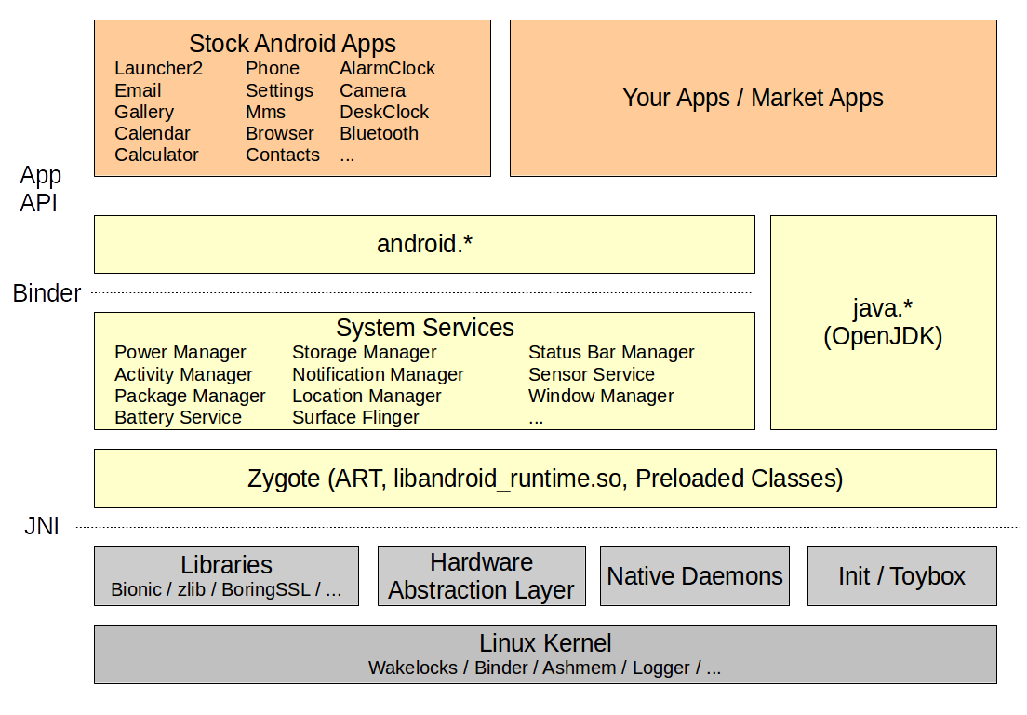
IV. JNI with Android
High-level overview of Android’s internals
Notes:
https://www.hatchmfg.com/android-treble-blessing-or-trouble-part-iii/

Slide 27
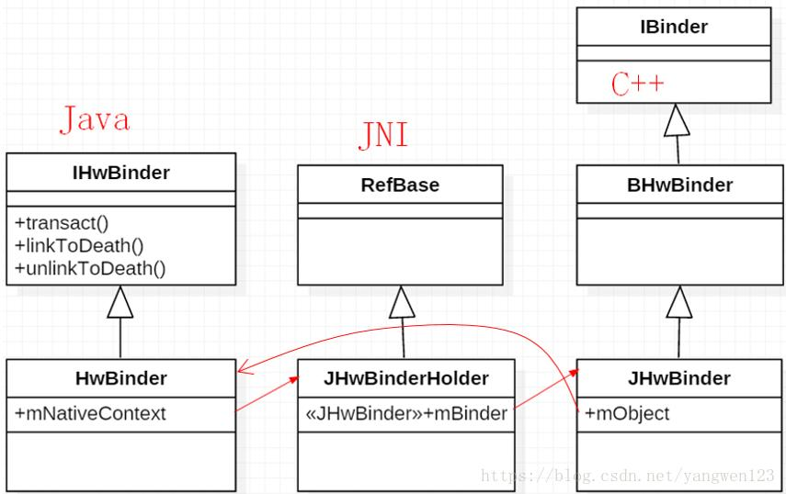
IV. JNI with Android
HIDL is intended to be used for inter-process communication (IPC). Communication between processes is referred to as Binderized. For libraries that must be linked to a process, a passthrough mode is also available (not supported in Java).
Notes:
http://www.programmersought.com/article/5936568742/

Slide 28
Thank you

